Slide 1
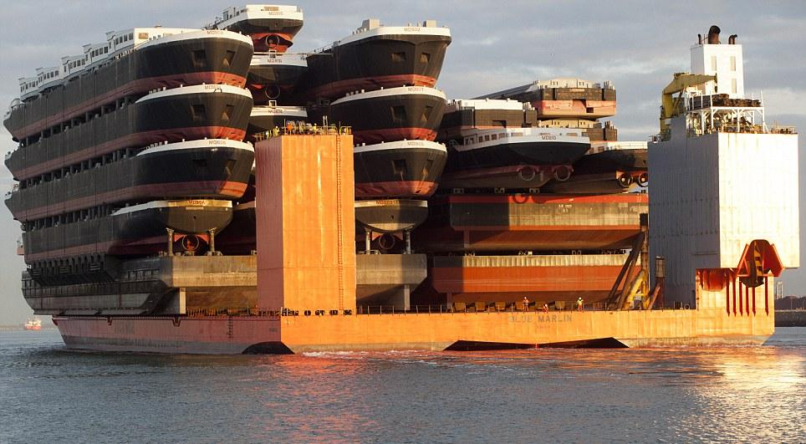
Mathematics of SHIPs

Slide 2
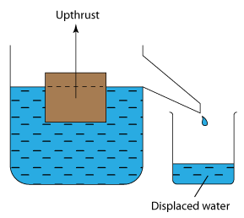
ARCHIMEDES PRINCIPLE
A steel ship can float by displacing an amount of water that is equal to its weight.
Image Source: http://www.one-school.net

Slide 3
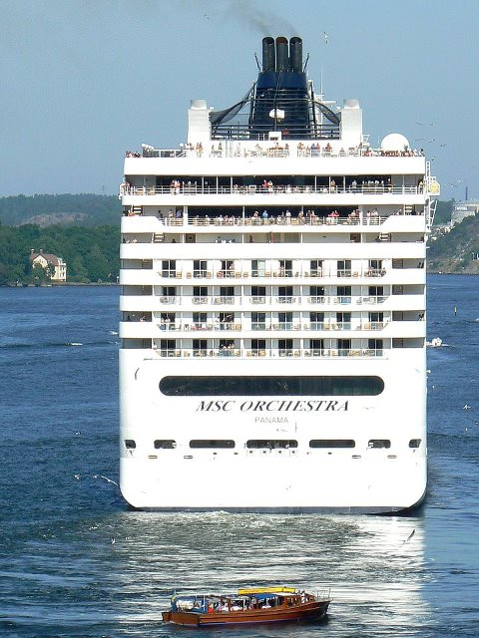
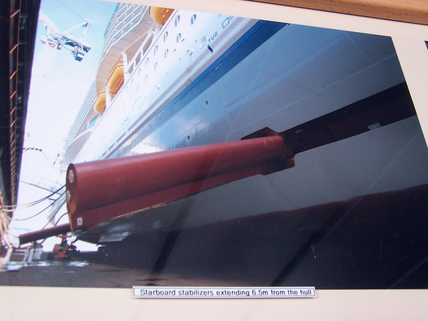
Stabilising a tall ship
Modern “Hotels on Ship Hulls” require wing stabilisers to remain upright even in light winds.
Images Source: Google Images

Slide 4
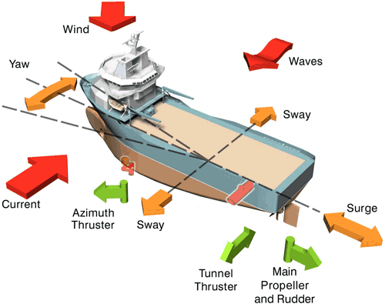
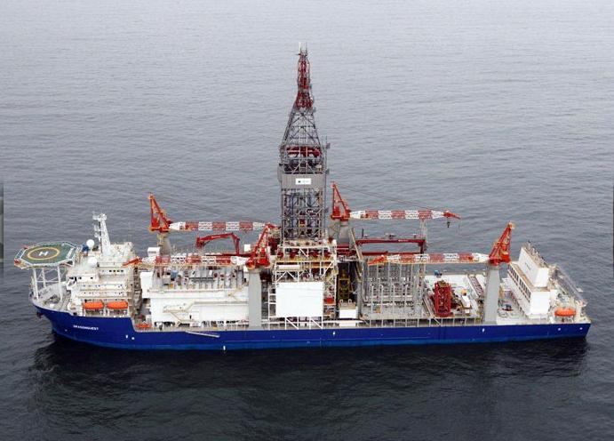
Dynamic Positioning
Dynamic Positioning is used in research ships and drilling vessels which venture into the deepest parts of the ocean where winds and waves are constantly changing.
Images Source: Google Images

Slide 5
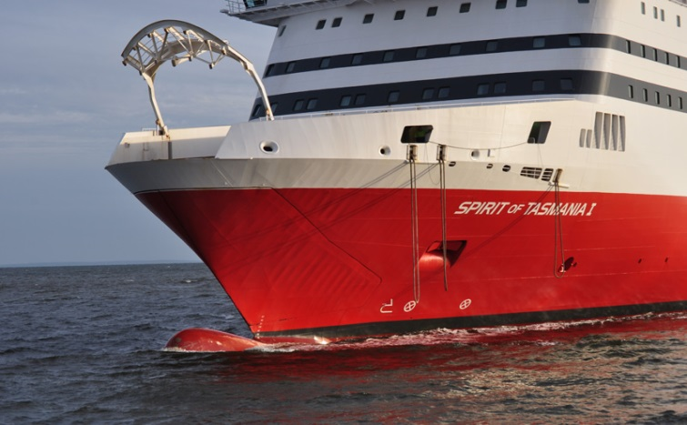
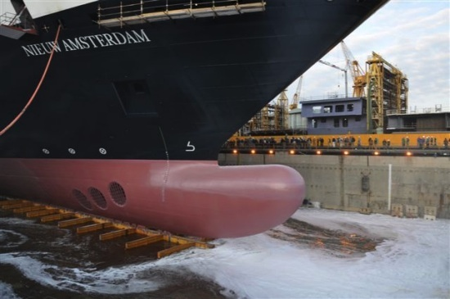
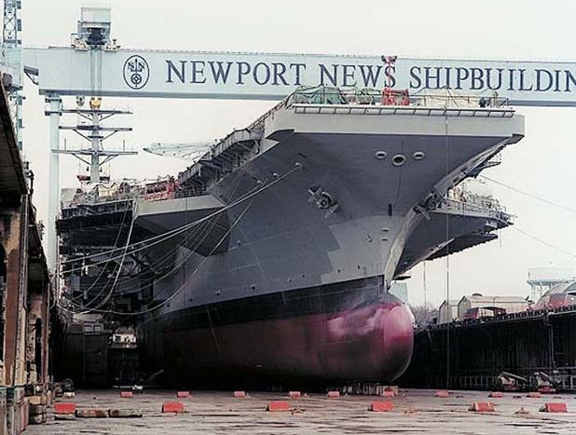
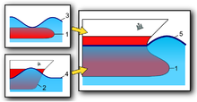
Bulbous bow
Ships have a bulb like protrusion under the water line which pushes out a bow wave to partially cancel the waves hitting the bow and provide “cutting through”.
Images Source: Google Images

Slide 6
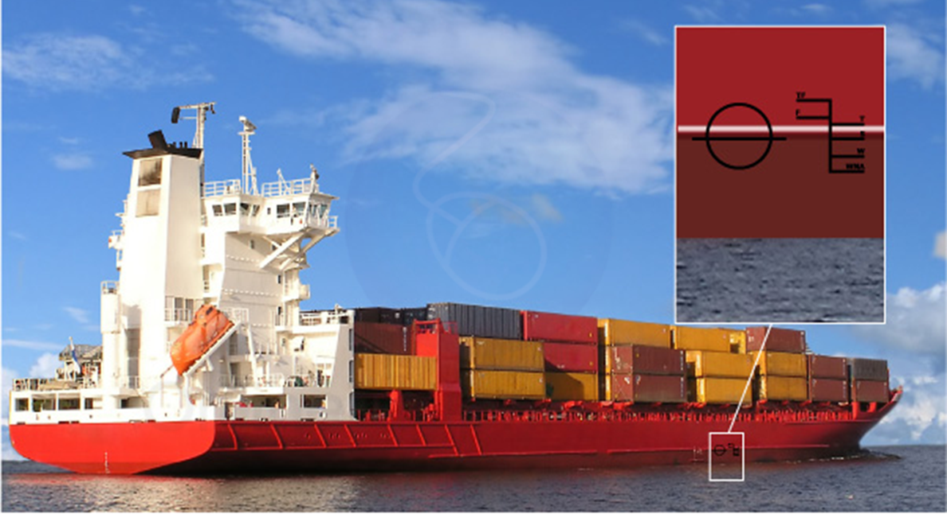
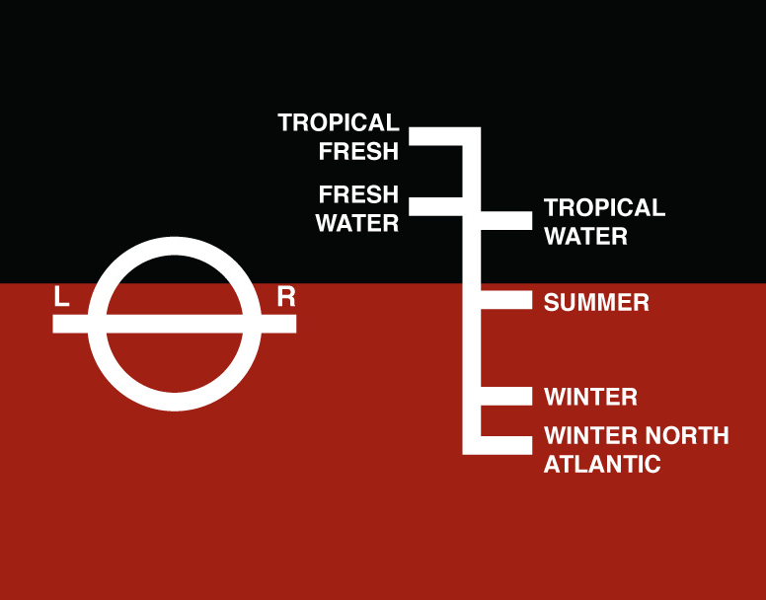
Loading ships – Plimsoll Line
Ships Float at Different Depths in different density waters. The “Plimsoll Line” marks the level at which a ship or boat floats in the water at different locations.
It indicates how much load is allowed at different types of water.
Image Source: http://www.marineinsight.com

Slide 7
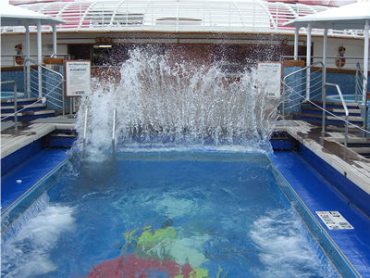
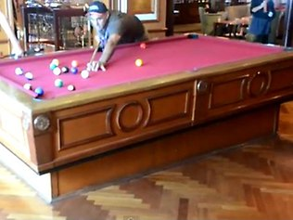
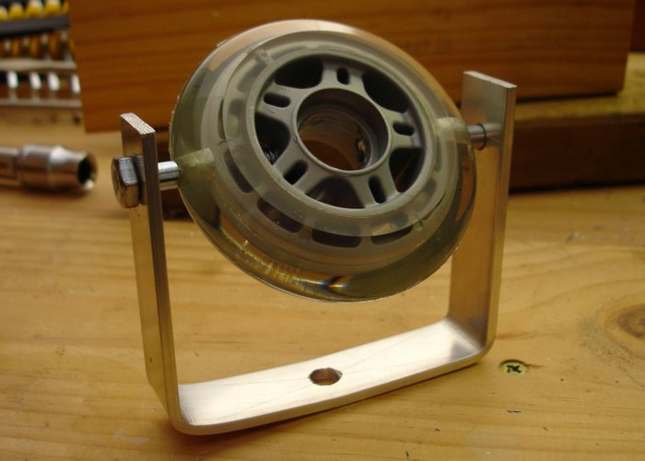
Rough seas mathematics
In rough seas there are issues with Swimming Pools and Billiard Tables.
Images Source: Google Images

Slide 8
Mathematics of SHIPs
Complete details of all material covered
in this presentation can be found in the
“Mathematics of Oceans” lesson on the
Passy’s World of Mathematics Website:
www.passyworldofmathematics.com

